Slide 1
Hands-On Activity: Exploring Arithmetic Sequences and Series
By: Melissa Medici
MTH 4040: Coordinating Seminar
April 2017

Slide 2
Goals and Objectives
Goal:
The students will demonstrate the ability to recognize patterns in a sequence and derive formulas for the sum of a series.
Objective:
The students will formulate an equation to represent an arithmetic sequence.
The students will build a summation to represent an arithmetic series.
The students will calculate the sum of the series.

Slide 3
Standards
NCTM:
Algebra (Grades 9-12)
Understand patterns, relations, and functions
1. Generalize patterns using explicitly defined and recursively defined functions
CCSS:
Building Functions F-BF
Building a function that models a relationship between two quantities.
1. Write a function that describes a relationship between two quantities.
a) Determine an explicit expression, a recursive process, or steps for calculation from a context.
b) Combine standard function types using arithmetic operations. For example, build a function that models that temperature of a cooling body by adding a constant function to a decaying exponential, and relate these functions to the model.

Slide 4
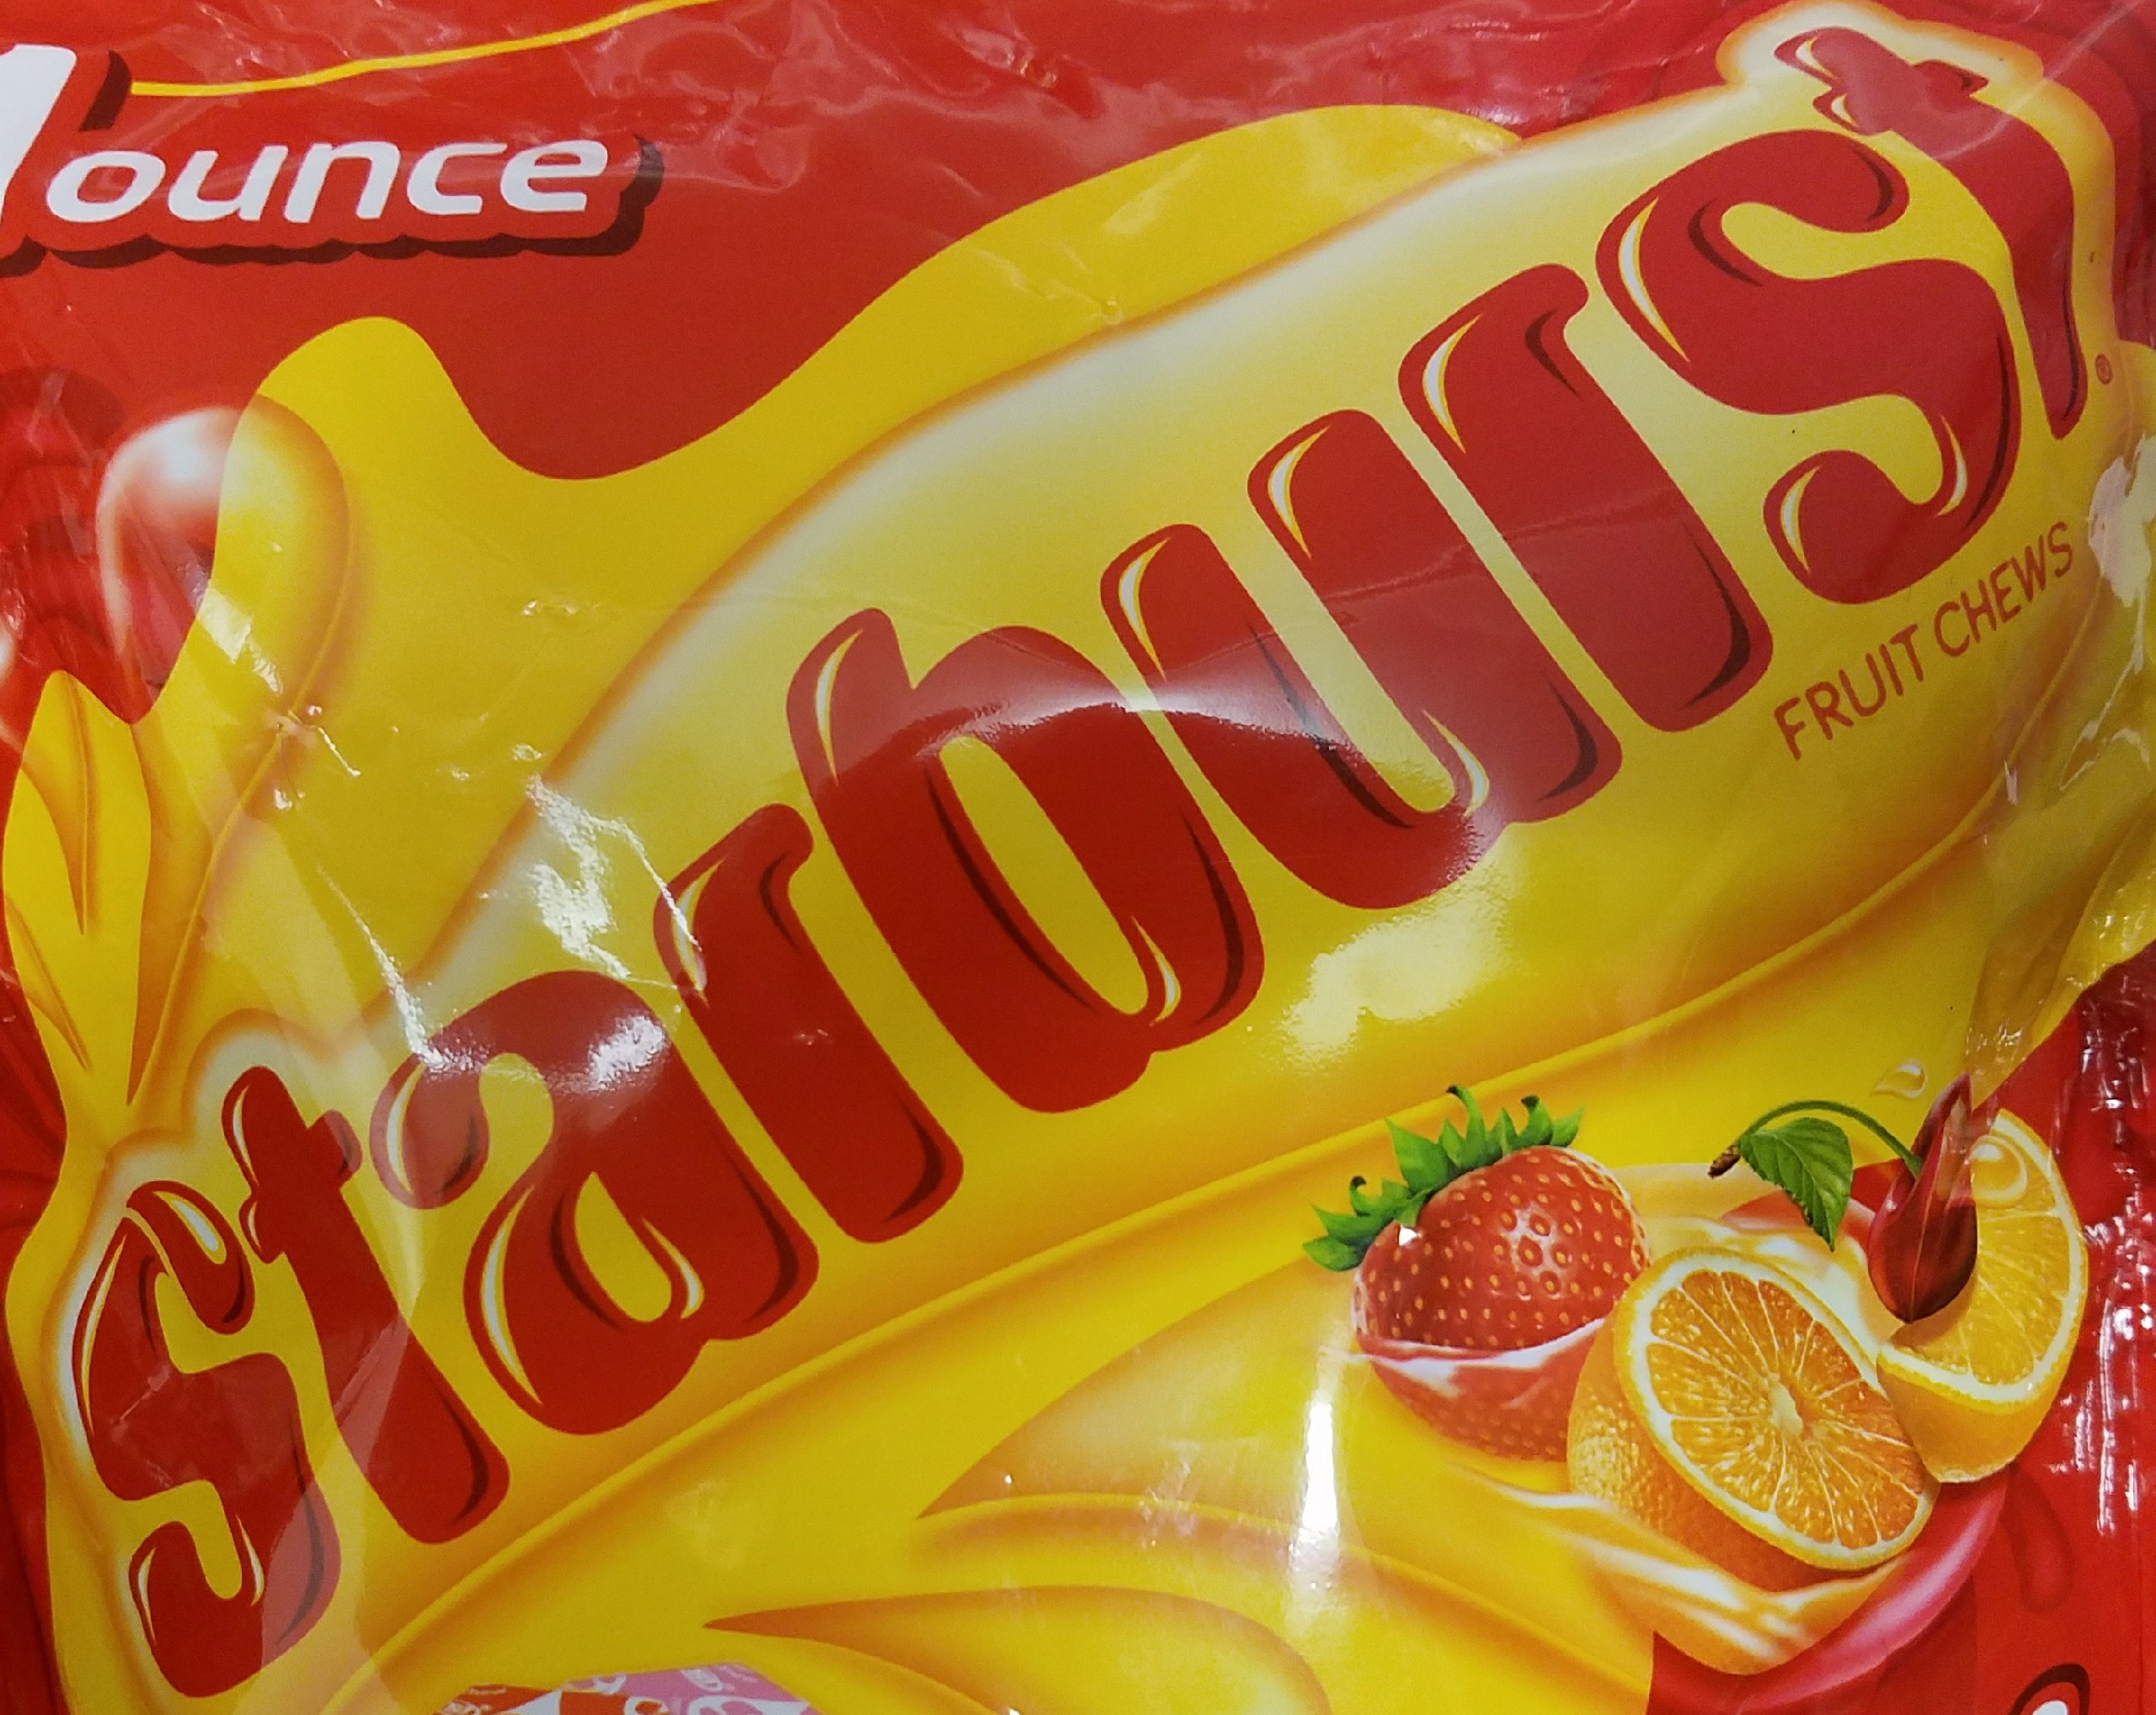
Materials/ Assignment
Materials:
Assignment:
Activity packet (1 per student)
Starburst: Pink (9 per group)
Starburst: Yellow (4 per group)
Starburst: Orange (1 per group)
Calculator (Optional)
The students will be working in groups of 3 to 4 to complete this activity. Each student will need their own copy of the activity packet, but will share the physical material amongst the group.

Slide 5
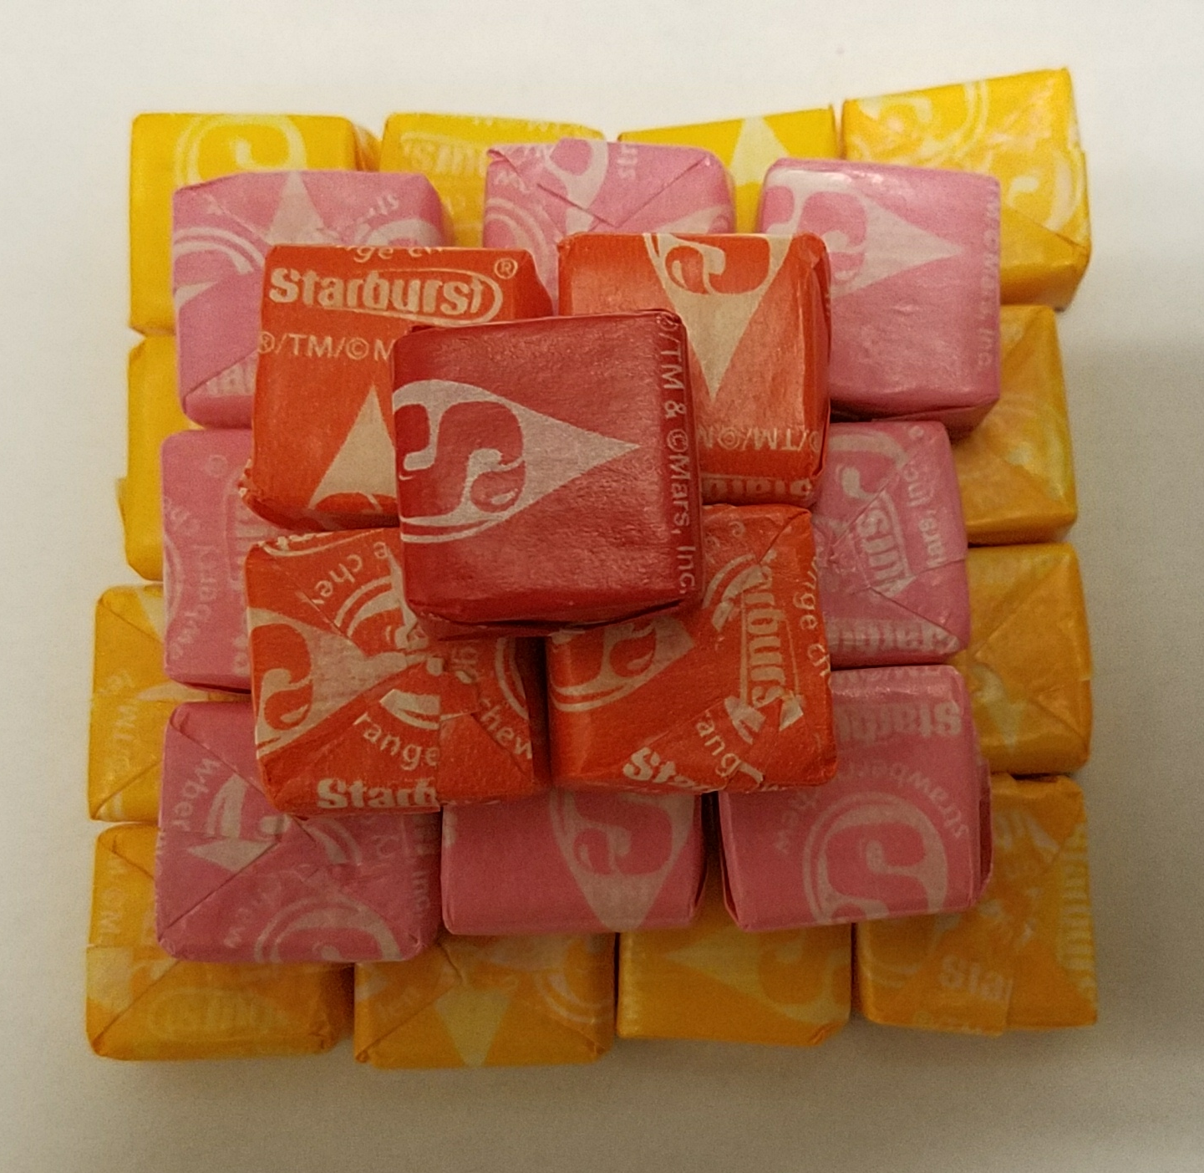
Terms to know
Sequence
A list of numbers or objects in a special order.
Series
The value you get when you add all the terms of
a sequence, this value is called the “sum”.
Summation
The addition of a sequence of numbers, the
result is their sum or total.
Arithmetic Patterns
A pattern made by adding the same value to
each term.
Common Difference
The difference between two numbers in an
arithmetic sequence.

Slide 6
Cannonball Problem: PREDICTIONS
1. Predict how many cannonballs are in the 5th row.
2. Predict how many cannonballs were used to build the figure in the picture?

Slide 7
Step 1
Build your pyramid. Place all your pink on the bottom, and then place your yellow starbursts on top of the pink. Next place your orange starburst on the top to finish off our pyramid.

Slide 8
Discover the relationship: ROWS
STEP 2
Examine the starburst in each row. What is the pattern that you notice?

Slide 9
Square Pyramid Data
Try to formulate a general equation to represent the pattern you found.
 | Sequence of the Rows | Series of the Square Pyramid
Figure 1 | 1
Figure 2 | 4
Figure 3 | 9
Figure n | ??

Slide 10
Discover the relationship: SQUARE PYRAMIDALS
STEP 3
Now that we have examined the starburst in each row and have discovered a pattern. Can we notice a pattern between the figures in this sequence?

Slide 11
Square Pyramid Data
Try to build a summation to represent the pattern you found.
 | Sequence of the Rows | Series of the Square Pyramid
Figure 1 | 1 | 1
Figure 2 | 4 | 5
Figure 3 | 9 | 14
Figure n |  | ??

Slide 12
Square Pyramid Data
 | Sequence of the Rows | Series of the Square Pyramid
Figure 1 | 1 | 1
Figure 2 | 4 | 5
Figure 3 | 9 | 14
Figure n

Slide 13
Cannonball Problem
1. Determine how many cannonballs are in the 5th row.
2. How many cannonballs are needed to build the figure in the picture?

Slide 14
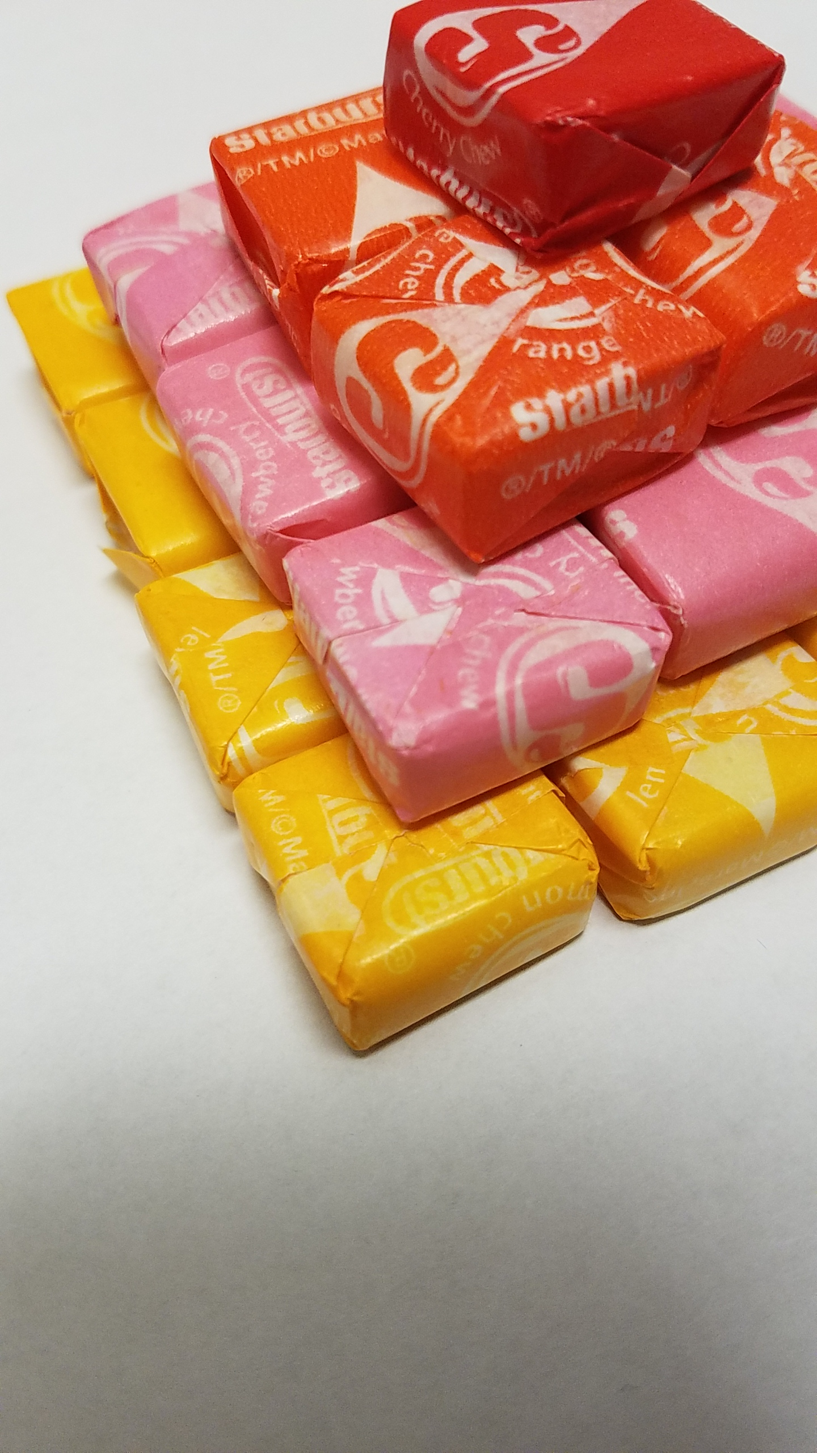
Practice:
Let’s practice using the two new formulas that we discovered!

Slide 15
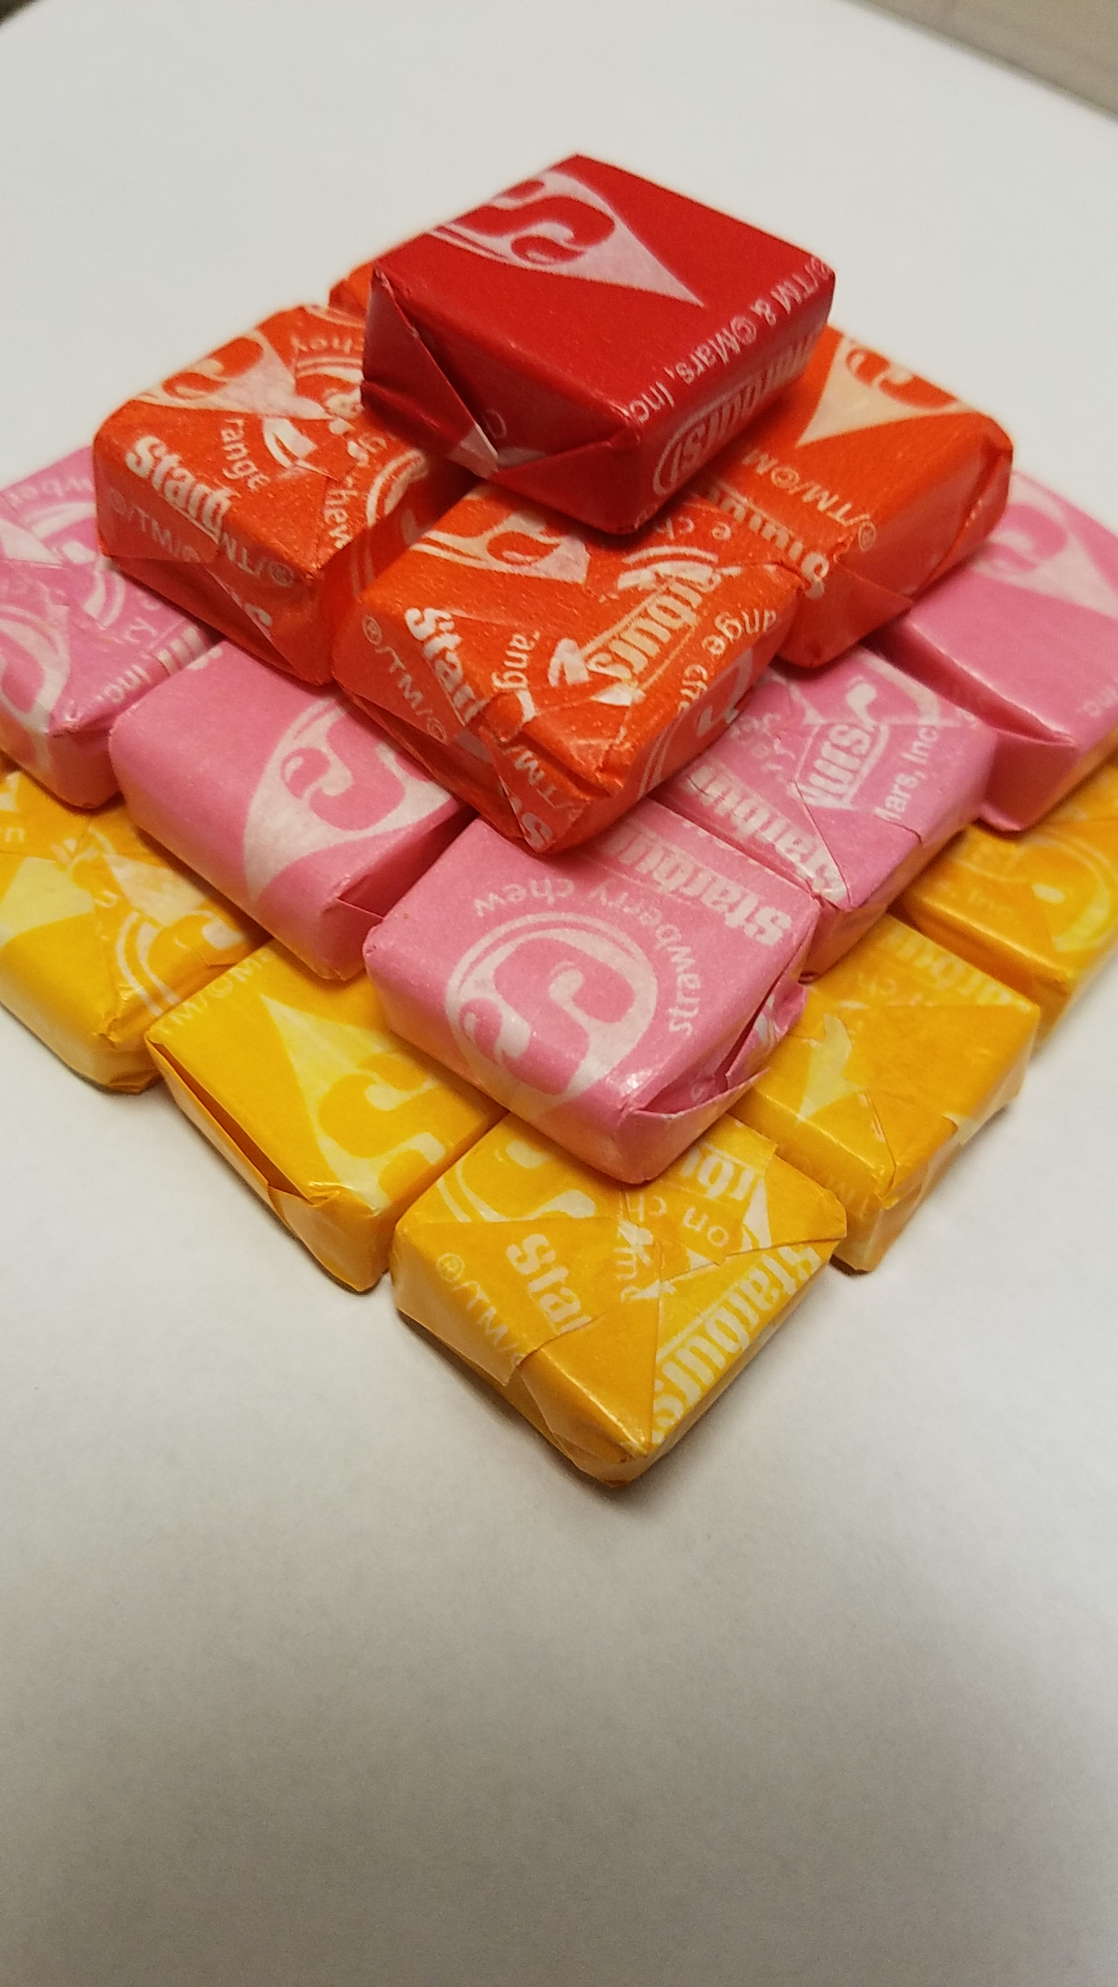
Practice:
How many starbursts would be required to build the 300th figure in this sequence?
How many starbursts will be in the 18th row of this square pyramidal?
How many starbursts will be in the 100th row of this square pyramidal?
How many starbursts would be required to build the 54th figure in this sequence?

Slide 16
Reflection
Melissa Medici
Did students struggle with definitions of terms? What vocabulary strategies might make learning these definitions easier for students?
What would be the biggest challenge for students with disabilities? What can be used to make that discovering the patterns easier to understand?

Slide 17
Resources
Love, D. (2014). 400 years ago, a famous mathematician couldn't confirm his theory computers did it two days ago. Retrieved from https://ca.finance.yahoo.com/news/400-years-ago-famous- mathematician-180433456.html

Slide 18
Any questions?
You can contact me at
MLMedici@optonline.net

